Slide 1
Compiler

Slide 2
What is a Compiler?
A compiler is a computer program that translates a program in a source language into an equivalent program in a target language.
A source program/code is a program/code written in the source language, which is usually a high-level language.
A target program/code is a program/code written in the target language, which often is a machine language or an intermediate code.
Source program
compiler
Target program
Error message

Slide 3
What Do Compilers Do (1)
A compiler acts as a translator,
transforming human-oriented programming languages
into computer-oriented machine languages.
Programming
Language
(Source)
Machine
Language
(Target)
Compiler

Slide 4
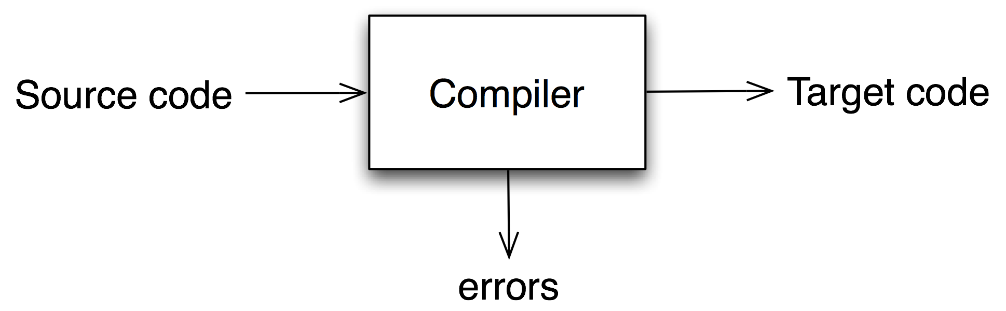
What is a compiler?
a program that translates an executable program in one language into an executable program in another language
Notes:
Translates “source code” into “target code”
we expect the program produced by the compiler to be “better”, in some way, than the original

Slide 5
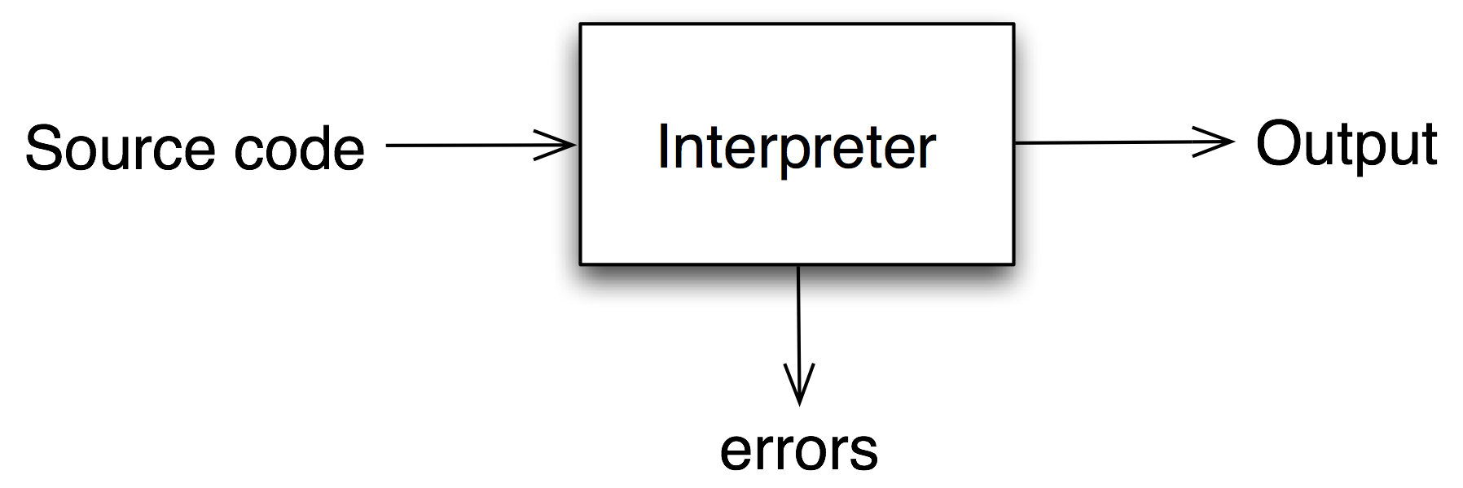
What is an interpreter?
a program that reads an executable program and produces the results of running that program
Notes:
usually, this involves executing the source program in some fashion

Slide 6
Process of Compiling
Stream of characters
scanner
Stream of tokens
parser
Parse/syntax tree
Semantic analyzer
Annotated tree
Intermediate code generator
Intermediate code
Code optimization
Intermediate code
Code generator
Target code
Code optimization
Target code

Slide 7
Some Data Structures
Symbol table
Literal table
Parse tree

Slide 8
Symbol Table
Identifiers are names of variables, constants, functions, data types, etc.
Store information associated with identifiers
  Information associated with different types of identifiers can be different
    Information associated with variables are name, type, address,size (for array), etc.
    Information associated with functions are name,type of return value, parameters, address, etc.

Slide 9
Symbol Table (cont’d)
Accessed in every phase of compilers
  The scanner, parser, and semantic analyzer put names of identifiers in symbol table.
  The semantic analyzer stores more information (e.g. data types) in the table.
  The intermediate code generator, code optimizer and code generator use information in symbol table to generate appropriate code.

Slide 10
Literal table
Store constants and strings used in program
  reduce the memory size by reusing constants and strings
Can be combined with symbol table

Slide 11
Parse tree
Information for different data types related to parse trees need to be stored somewhere.
  Nodes are variant records, storing information for different types of data
  Nodes store pointers to information stored in other data structure, e.g. symbol table

Slide 12
Scanning
A scanner reads a stream of characters and puts them together into some meaningful (with respect to the source language) units called tokens.
It produces a stream of tokens for the next phase of compiler.

Slide 13
Parsing
A parser gets a stream of tokens from the scanner, and determines if the syntax (structure) of the program is correct according to the (context-free) grammar of the source language.
Then, it produces a data structure, called a parse tree or an abstract syntax tree, which describes the syntactic structure of the program.

Slide 14
Semantic analysis
It gets the parse tree from the parser together with information about some syntactic elements
It determines if the semantics or meaning of the program is correct.
Mostly, a semantic analyzer does type checking.
It modifies the parse tree in order to get that semantically correct code.

Slide 15
Intermediate code generation
An intermediate code generator
  takes a parse tree from the semantic analyzer
  generates a program in the intermediate language.
In some compilers, a source program is translated into an intermediate code first and then the intermediate code is translated into the target language.
In other compilers, a source program is translated directly into the target language.

Slide 16
Code optimization
Replacing an inefficient sequence of instructions with a better sequence of instructions.
Sometimes called code improvement.
Code optimization can be done:
  after semantic analyzing
    performed on a parse tree
  after intermediate code generation
    performed on a intermediate code
  after code generation
    performed on a target code

Slide 17
Code generation
A code generator
  takes either an intermediate code or a parse tree
  produces a target program.

Slide 18
Error Handling
Error can be found in every phase of compilation.
  Errors found during compilation are called static (or compile-time) errors.
  Errors found during execution are called dynamic (or run-time) errors
Compilers need to detect, report, and recover from error found in source programs
Error handlers are different in different phases of compiler.

Slide 19
The Structure of a Compiler
Any compiler must perform two major tasks
  Analysis of the source program
  Synthesis of a machine-language program
Compiler
Analysis
Synthesis

Slide 20






The Structure of a Compiler (contd…)
Source
Program
Scanner
Tokens
Parser
Syntactic
Semantic
Routines
(Character Stream)
Structure
Intermediate
Representation
Symbol and
Attribute
Tables
Optimizer
(Used by all Phases of The Compiler)
Code
Generator
Target machine code

Slide 21


The Structure of a Compiler (contd…)
Source
Program
Scanner
Tokens
Parser
Syntactic
Semantic
Routines
(Character Stream)
Structure
Intermediate
Representation
Scanner
  The scanner begins the analysis of the source program by reading the input, character by character, and grouping characters into individual words and symbols (tokens)
Symbol and
Attribute
Tables
Optimizer
(Used by all
Phases of
The Compiler)
Code
Generator
Target machine code

Slide 22

The Structure of a Compiler (contd…)
Source
Program
Scanner
Tokens
Parser
Syntactic
Semantic
Routines
(Character Stream)
Structure
Intermediate
Representation
Parser
Given a formal syntax specification (typically as a context-free grammar [CFG] ), the parse reads tokens and groups them into units as specified by the productions of the CFG being used.
As syntactic structure is recognized, the parser either calls corresponding semantic routines directly or builds a syntax tree.
Symbol and
Attribute
Tables
Optimizer
(Used by all
Phases of
The Compiler)
Code
Generator
Target machine code

Slide 23


The Structure of a Compiler (5)
Source
Program
Scanner
Tokens
Parser
Syntactic
Semantic
Routines
(Character Stream)
Structure
Intermediate
Representation
Semantic Routines
Perform two functions
  Check the static semantics of each construct
  Do the actual translation
The heart of a compiler
Symbol and
Attribute
Tables
Optimizer
(Used by all
Phases of
The Compiler)
Code
Generator
Target machine code

Slide 24


The Structure of a Compiler (6)
Source
Program
Scanner
Tokens
Parser
Syntactic
Semantic
Routines
(Character Stream)
Structure
Intermediate
Representation
Optimizer
The IR code generated by the semantic routines is analyzed and transformed into functionally equivalent but improved IR code
This phase can be very complex and slow
Symbol and
Attribute
Tables
Optimizer
(Used by all
Phases of
The Compiler)
Code
Generator
Target machine code

Slide 25
The Phases of a Compiler
Phase | Output | Sample
Programmer (source code producer) | Source string | A=B+C;
Scanner (performs lexical analysis) | Token string | ‘A’, ‘=’, ‘B’, ‘+’, ‘C’, ‘;’ And symbol table with names
Parser (performs syntax analysis based on the grammar of the programming language) | Parse tree or abstract syntax tree | ; | = / \ A + / \ B C
Semantic analyzer (type checking, etc) | Annotated parse tree or abstract syntax tree
Intermediate code generator | Three-address code, quads, or RTL | int2fp B t1 + t1 C t2 := t2 A
Optimizer | Three-address code, quads, or RTL | int2fp B t1 + t1 #2.3 A
Code generator | Assembly code | MOVF #2.3,r1 ADDF2 r1,r2 MOVF r2,A
Peephole optimizer | Assembly code | ADDF2 #2.3,r2 MOVF r2,A

Slide 26
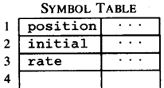


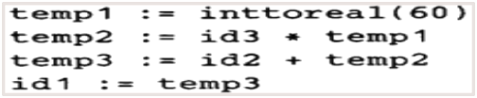



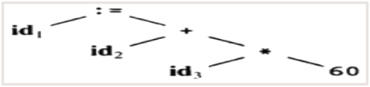



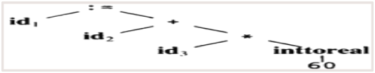
Structure of a Compiler(Example)
Code Generator
[Intermediate Code Generator]
Non-optimized Intermediate Code
Scanner
[Lexical Analyzer]
Tokens
Code Optimizer
Parser
[Syntax Analyzer]
Optimized Intermediate Code
Parse tree
Code Optimizer
Semantic Process
[Semantic analyzer]
Target machine code
Abstract Syntax Tree w/ Attributes

Slide 27
What qualities are important in a compiler?
Correct code
Output runs fast
Compiler runs fast
Consistent, predictable
Notes:
Each of these shapes your feelings about the correct contents of this course

